Slide 2
Monday
Day 1

Slide 3
Sonday
Objective: TLW know and apply grade level phonics and word analysis skills when decoding isolated words in text. Use combined knowledge of letters and sound correspondences, syllabications patterns, and morphology (roots & affixes) to accurately read unfamiliar multisyllabic words.

Slide 4
Sonday Lesson 46

Slide 5
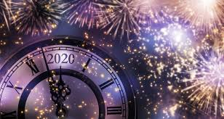
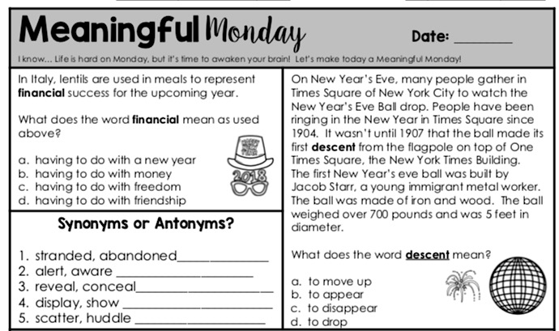
Day 1 Reading Review

Slide 6
READING – DAY 1
CCRA.R.1 Read Closely to determine what the text says explicitly and to make logical inferences from it; cite specific textual evidence when writing or speaking to support conclusions from the text.
ESSENTIAL QUESTION
What is the importance in having small dreams and believing in yourself?

Slide 7
READING – DAY 1
Reading Day 1:
Storyworks – Silver Dollar Dreams
Vocabulary Skill Builder
Behind the Scenes
First Read

Slide 8
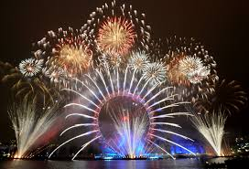
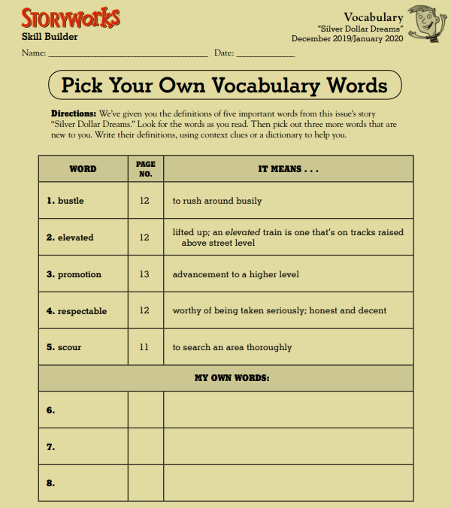
Vocabulary

Slide 9
READING – DAY 1
Grammar Day 1:
Objective: Demonstrate command of conventions of standard English grammar and usage when speaking an conventions of standard English grammar and usage, including capitalization and punctuation, when writing.
Relative pronouns and relative adverbs - Progressive verb tenses
Auxiliary verbs - Produce clear sentences
Form and use prepositional phrases - Recognize fragments & run-ons
Use commas & quotations

Slide 10
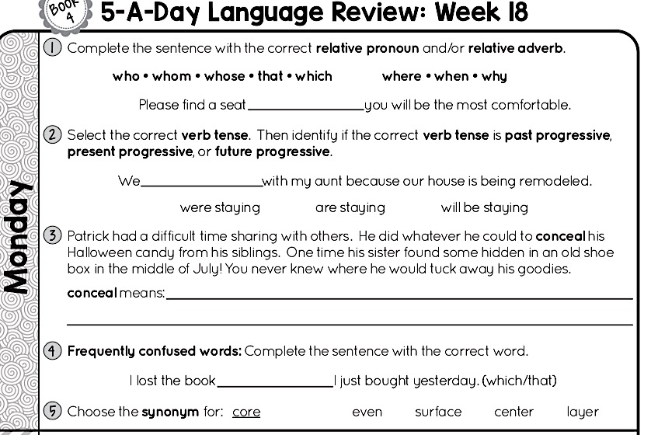

Slide 11
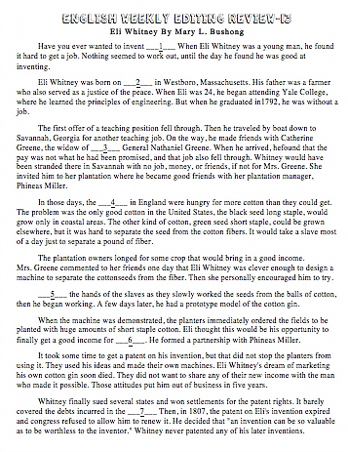
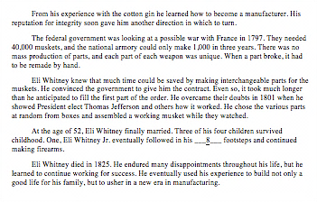
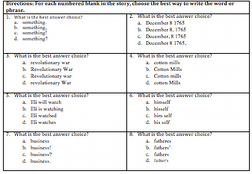

Slide 12
Grammar
Adages ppt.

Slide 13
Day 2
Tuesday

Slide 14
Sonday
Objective: TLW know and apply grade level phonics and word analysis skills when decoding isolated words in text. Use combined knowledge of letters and sound correspondences, syllabications patterns, and morphology (roots & affixes) to accurately read unfamiliar multisyllabic words.

Slide 15
Sonday Lesson 47

Slide 16
Day 2 Reading Review

Slide 17
READING – DAY 1
CCRA.R.1 Read Closely to determine what the text says explicitly and to make logical inferences from it; cite specific textual evidence when writing or speaking to support conclusions from the text.
ESSENTIAL QUESTION
How will Alex ever earn his orange belt in karate?

Slide 18
READING – DAY 1
Reading Day 2:
Read/listen to the article again.
Close-reading questions.
Critical-thinking questions

Slide 19
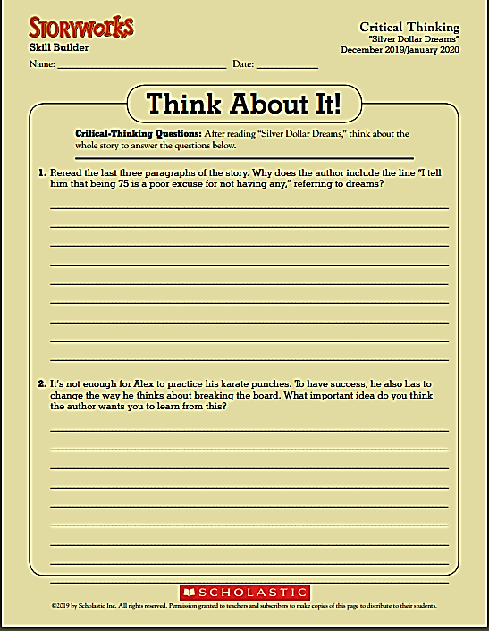

Slide 20
READING – DAY 1
Grammar Day 2:
Objective: Demonstrate command of conventions of standard English grammar and usage when speaking an conventions of standard English grammar and usage, including capitalization and punctuation, when writing.
Relative pronouns and relative adverbs - Progressive verb tenses
Auxiliary verbs - Produce clear sentences
Form and use prepositional phrases - Recognize fragments & run-ons
Use commas & quotations

Slide 22
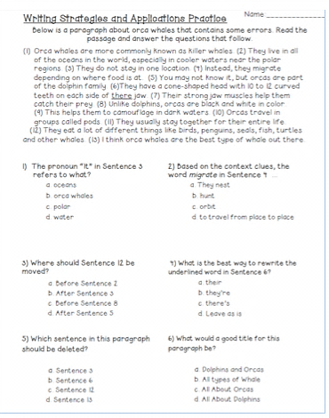
Day 2 - Editing

Slide 23
READING – DAY 1
Grammar Day 2:
Proverbs ppt

Slide 24
Day 3
Wednesday

Slide 25
Sonday
Objective: TLW know and apply grade level phonics and word analysis skills when decoding isolated words in text. Use combined knowledge of letters and sound correspondences, syllabications patterns, and morphology (roots & affixes) to accurately read unfamiliar multisyllabic words.

Slide 26
Sonday Lesson 48

Slide 27
Day 3 Reading Review

Slide 28
READING – DAY 1
CCRA.R.1 Read Closely to determine what the text says explicitly and to make logical inferences from it; cite specific textual evidence when writing or speaking to support conclusions from the text.
ESSENTIAL QUESTION
What is the importance in having small dreams and believing in yourself?

Slide 29
READING – DAY 1
Reading Day 3:
Character

Slide 30
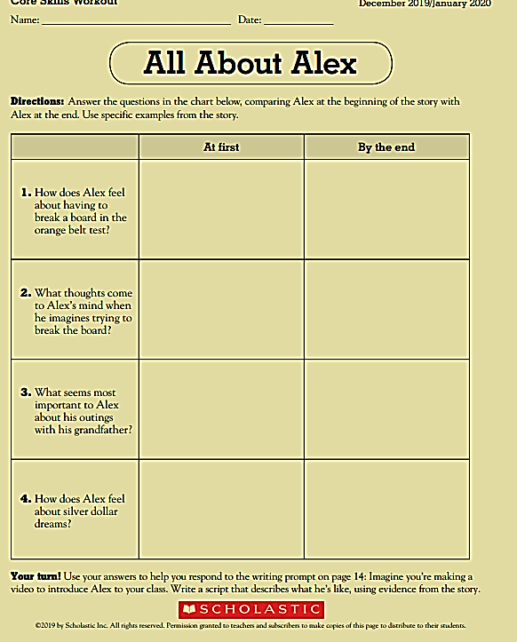

Slide 31
READING – DAY 1
Grammar Day 3:
Objective: Demonstrate command of conventions of standard English grammar and usage when speaking an conventions of standard English grammar and usage, including capitalization and punctuation, when writing.
Relative pronouns and relative adverbs - Progressive verb tenses
Auxiliary verbs - Produce clear sentences
Form and use prepositional phrases - Recognize fragments & run-ons
Use commas & quotations

Slide 33
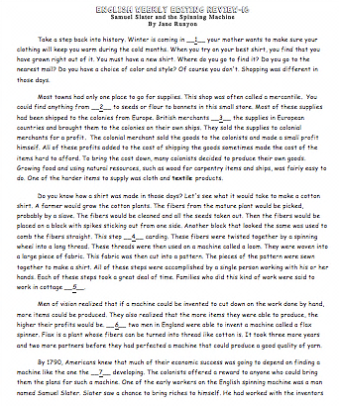
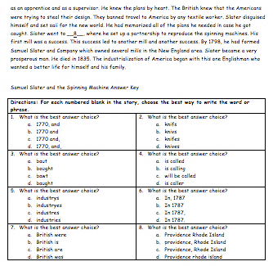
Day 3 - Editing

Slide 34
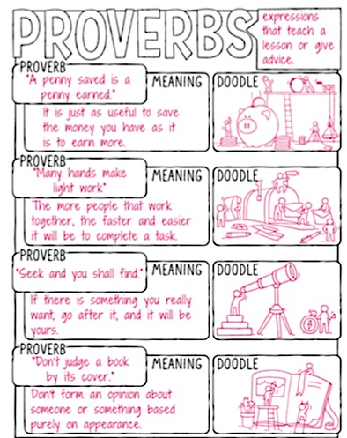
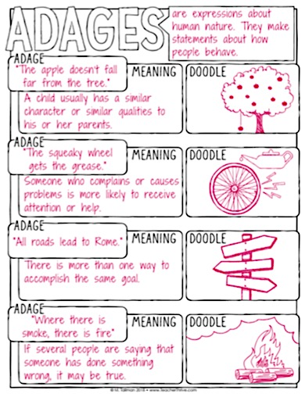

Slide 35
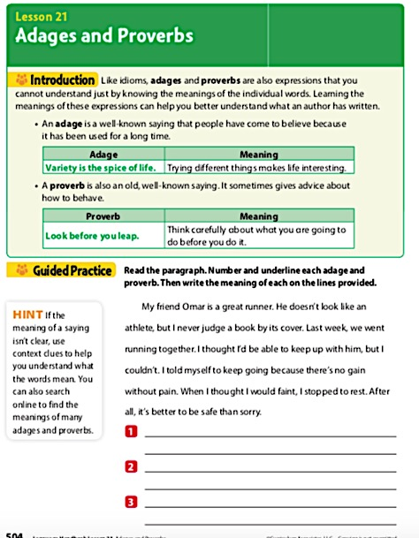
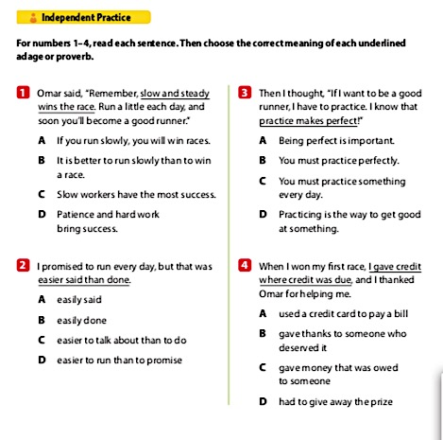

Slide 36
Day 4
Thursday

Slide 37
Sonday
Objective: TLW know and apply grade level phonics and word analysis skills when decoding isolated words in text. Use combined knowledge of letters and sound correspondences, syllabications patterns, and morphology (roots & affixes) to accurately read unfamiliar multisyllabic words.

Slide 38
Sonday Lesson 49

Slide 39
Day 4 Reading Review

Slide 40
READING – DAY 1
CCRA.R.1 Read Closely to determine what the text says explicitly and to make logical inferences from it; cite specific textual evidence when writing or speaking to support conclusions from the text.
ESSENTIAL QUESTION
What is the importance in having small dreams and believing in yourself?

Slide 41
Reading
Inferences

Slide 42
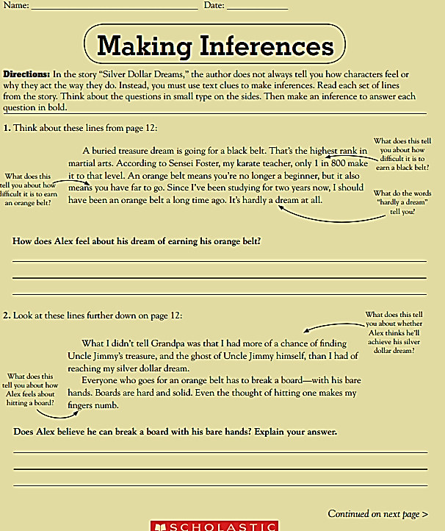
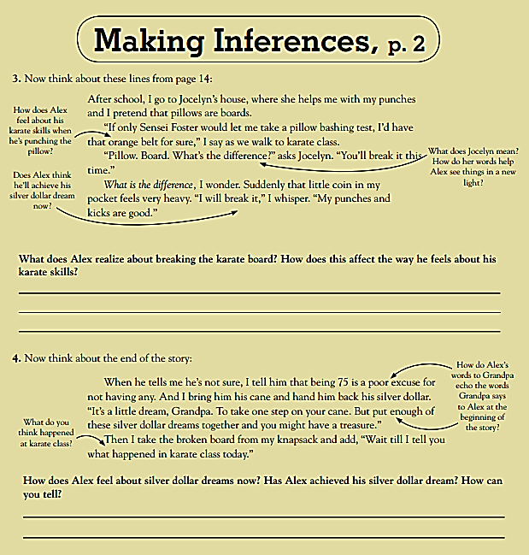

Slide 43
READING – DAY 1
Grammar Day 4:
Objective: Demonstrate command of conventions of standard English grammar and usage when speaking an conventions of standard English grammar and usage, including capitalization and punctuation, when writing.
Relative pronouns and relative adverbs - Progressive verb tenses
Auxiliary verbs - Produce clear sentences
Form and use prepositional phrases - Recognize fragments & run-ons
Use commas & quotations

Slide 44
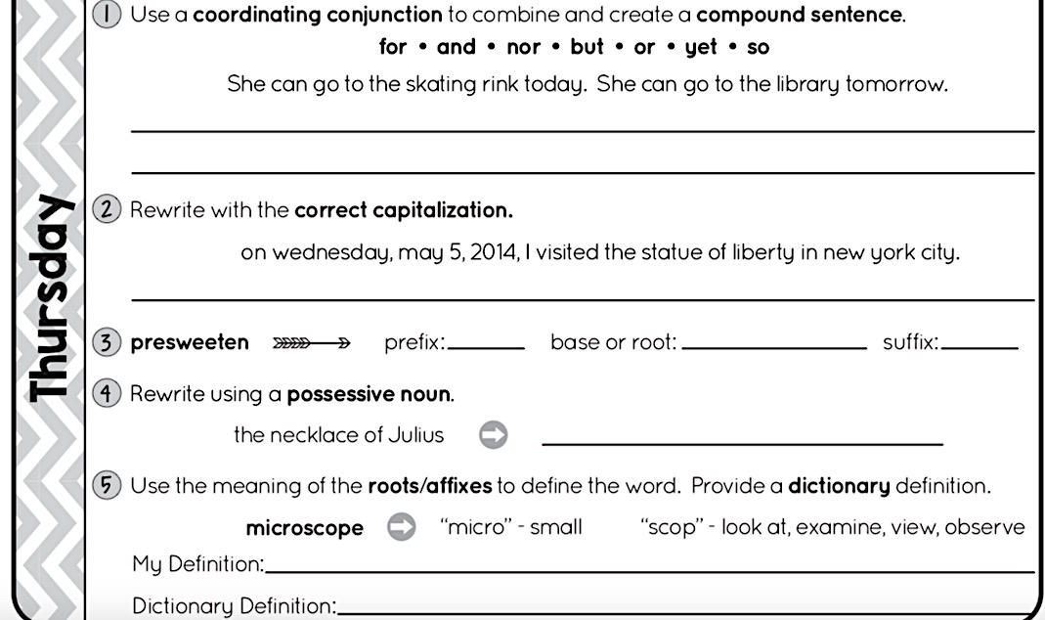

Slide 45
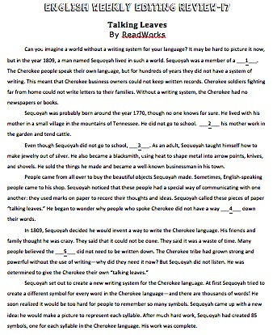
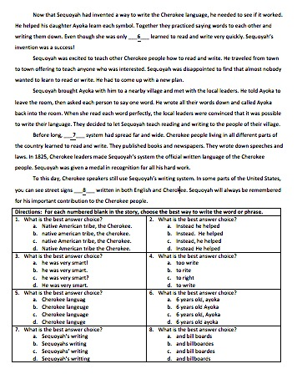

Slide 46
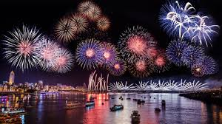
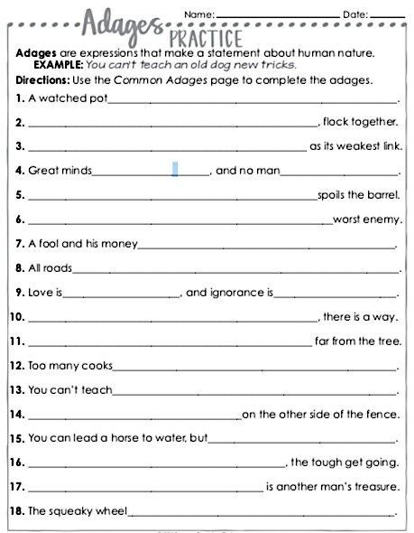
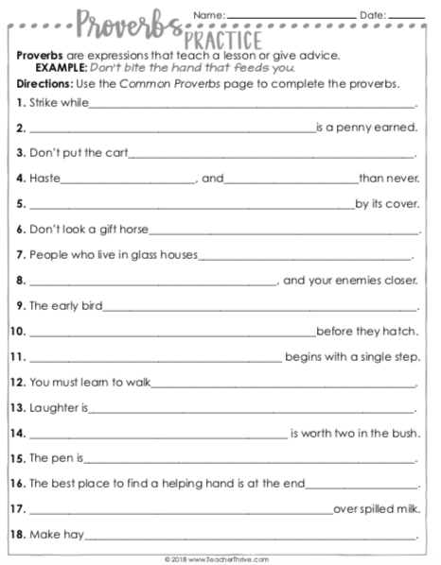

Slide 47
Day 5
Thursday

Slide 48
Day 5 Reading Review

Slide 49
Sonday Lesson 50
Grammar Assessment
Reading Assessment

