Slide 1
ELA January 21st – 24th

Slide 2
Tuesday

Slide 3
Sonday
Objective: TLW know and apply grade level phonics and word analysis skills when decoding isolated words in text. Use combined knowledge of letters and sound correspondences, syllabications patterns, and morphology (roots & affixes) to accurately read unfamiliar multisyllabic words.

Slide 4
Lesson 56
Root: mit/miss/misison
Meaning – to sent

Slide 5
Reading Review

Slide 6
Reading Review

Slide 7
Standards
Standards Reviewed
R.1, R.2, R.3, R.4, W.1, SL.1, L.5, L.6
Featured Skill
Genre
Essential Question
What is a play and Greek Mythology and what can I learn from reading this type of text?

Slide 8
Standards
What do you already know about Greek myths, this genre, or this type of story? (turn and talk)
Look at the illustration on pages 20-21
Who is each god or goddess?
How does the picture of each one suggest what he or she rules over? (turn and talk)
Mt. Olympus is in the background. This is where the gods and goddesses of Greek mythology lived.

Slide 9
Standards
Look at the title and subtitle. What does this tell you about the gods?
What does revenge mean?
Do you think the gods and goddesses always do what’s best for humans?
Read the “Up Close” box: “Some myths explain something, and some teach a lesson. This one does both!”
Now read the writing prompt along with me – “In this myth, why do the gods get revenge on Echo and Narcissus? Are the gods being fair? Send (write) an essay answering both questions to “Echo Contest”.
Keep these in mind (the upclose and writing prompt) as we read the play later.
Now, look at the light blue burst in the play. These are here to help you understand how certain words in English are related to this myth. (Vocabuary tips)

Slide 10
Distribute Vocabulary Skill Builder

Slide 11
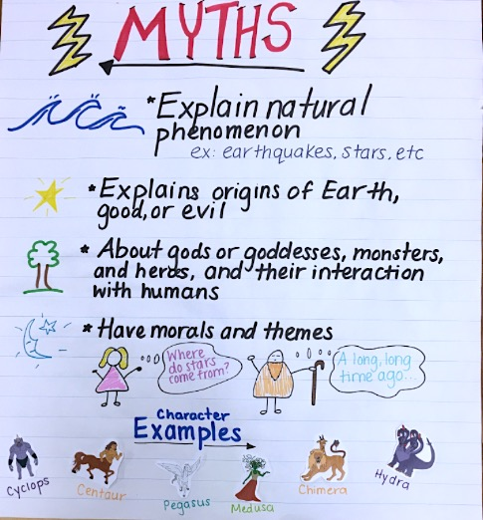
Standards
Anchor Chart

Slide 12
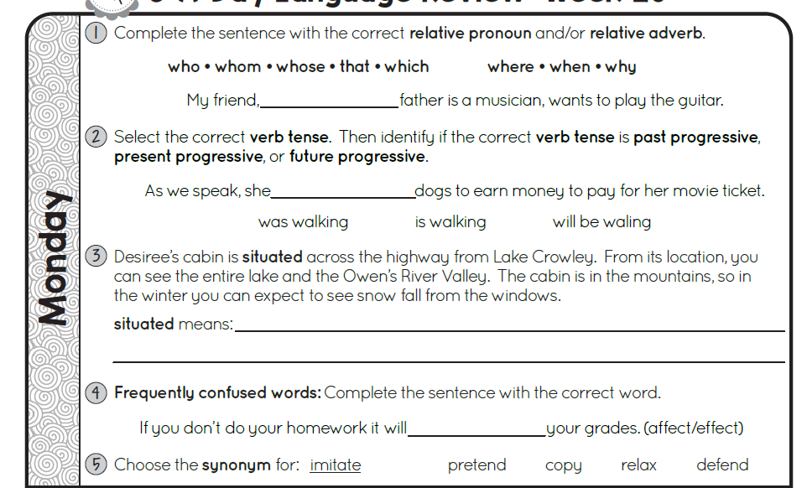
Grammar

Slide 13
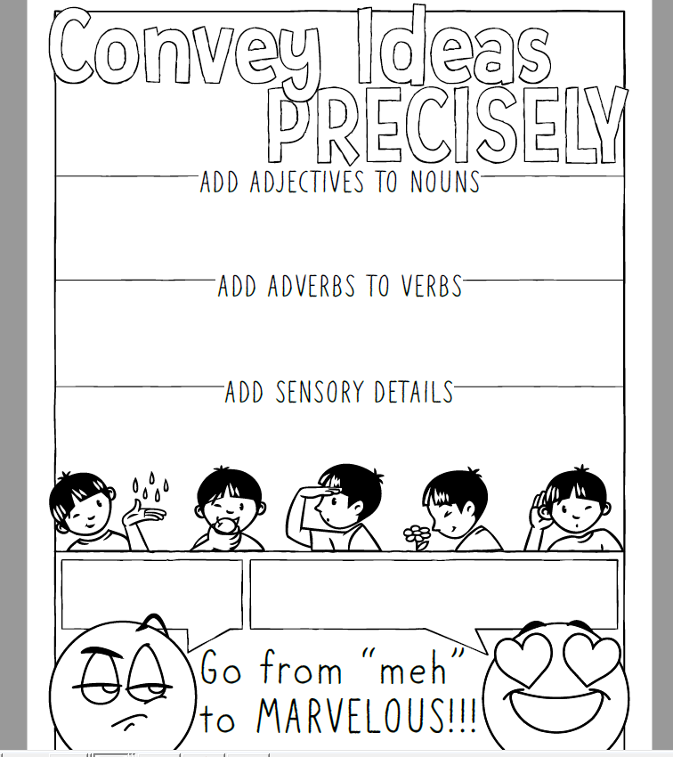
New Learning: Conveying Ideas Precisely
**Complete your journal entry while participating in the PowerPoint lesson

Slide 14
Wednesday

Slide 15
Sonday
Objective: TLW know and apply grade level phonics and word analysis skills when decoding isolated words in text. Use combined knowledge of letters and sound correspondences, syllabications patterns, and morphology (roots & affixes) to accurately read unfamiliar multisyllabic words.

Slide 16
Lesson 57
Sight Words
rough
tough
enough

Slide 17
Reading Review

Slide 18
Standards
Standards Reviewed
R.1, R.2, R.3, R.4, W.1, SL.1, L.5, L.6
Featured Skill
Genre
Essential Question
What is a play and Greek Mythology and what can I learn from reading this type of text?

Slide 19
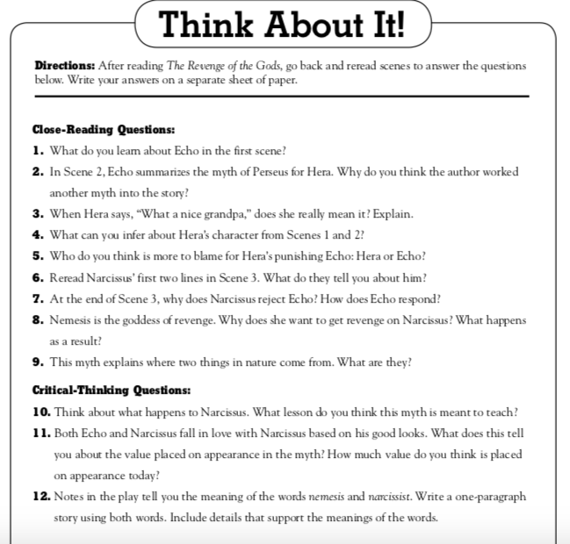
Read the play.
Discuss the Close-Reading and Critical-Thinking Questions.

Slide 20
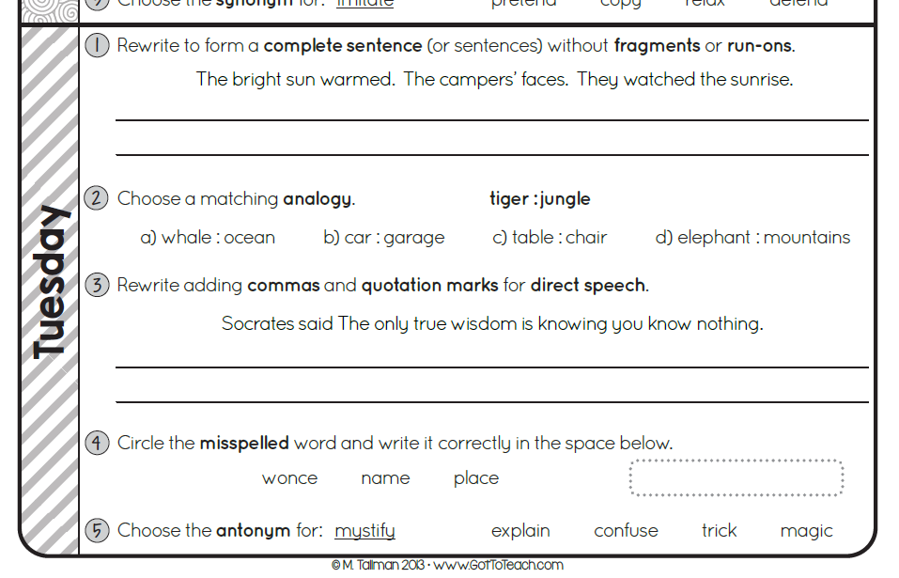

Slide 21
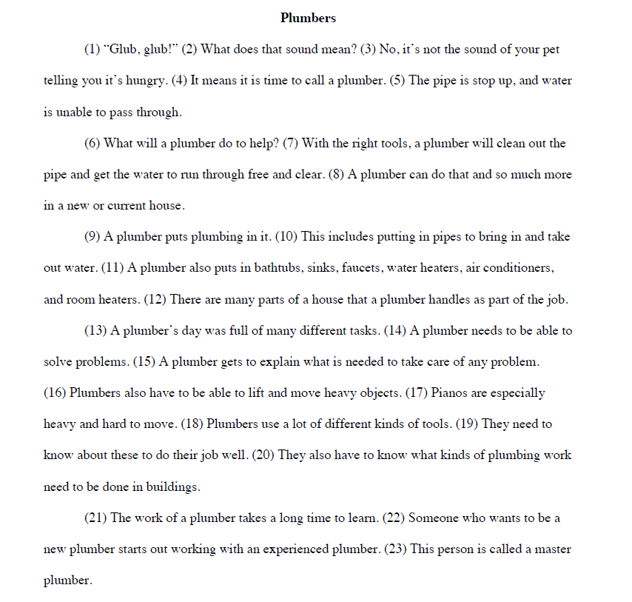
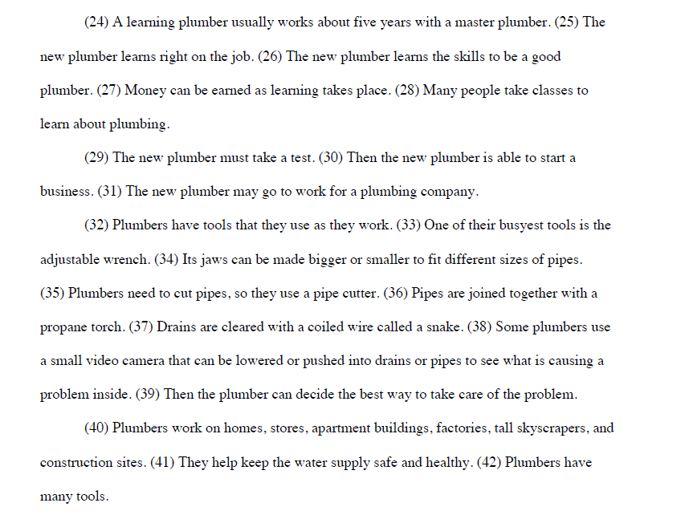

Slide 23
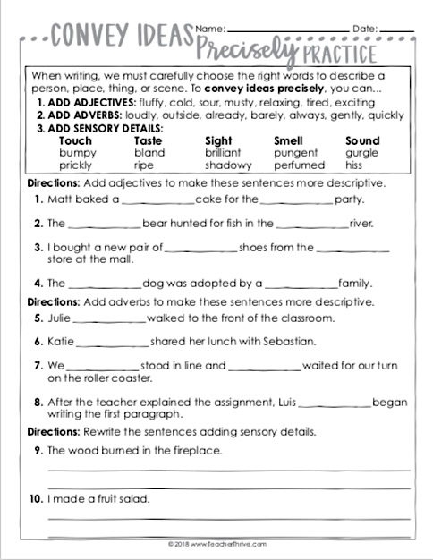

Slide 24
Thursday

Slide 25
Sonday
Objective: TLW know and apply grade level phonics and word analysis skills when decoding isolated words in text. Use combined knowledge of letters and sound correspondences, syllabications patterns, and morphology (roots & affixes) to accurately read unfamiliar multisyllabic words.

Slide 26
Lesson 58 & 59
Roots:
-sion: as in mission
cuss: Meaning-to hit
press: Meaning – to push
Sounds:
ue /oo/ as in blue
long /u/ as in cue

Slide 27
Reading Review

Slide 28
Standards
Standards Reviewed
R.1, R.2, R.3, R.4, W.1, SL.1, L.5, L.6
Featured Skill
Genre
Essential Question
What is a play and Greek Mythology and what can I learn from reading this type of text?

Slide 29
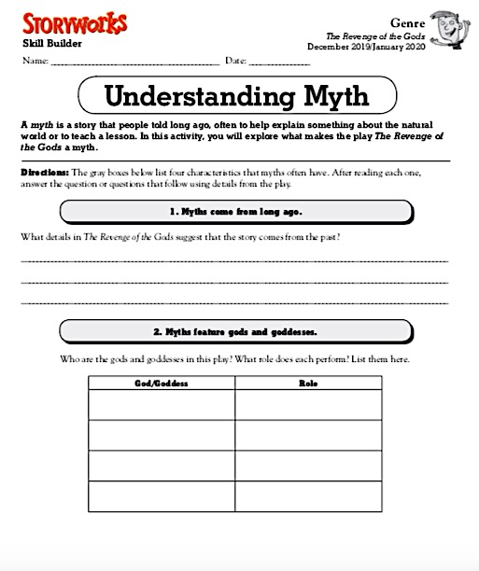
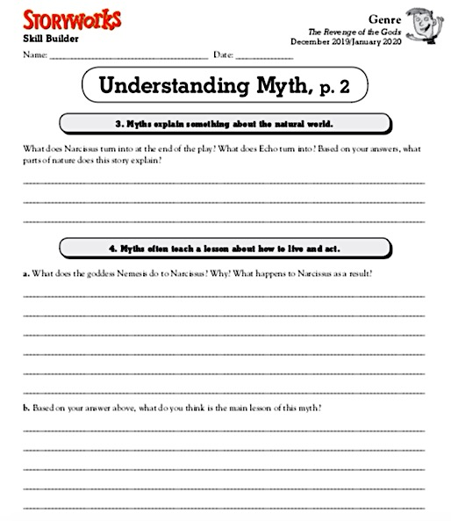

Slide 30
Writing Prompt

Slide 33
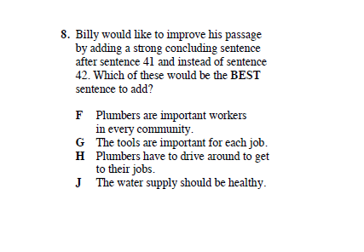

Slide 34
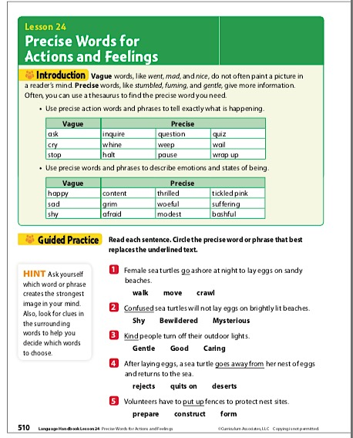
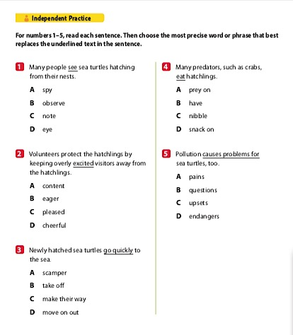

Slide 35
Friday

Slide 36
Sonday
Objective: TLW know and apply grade level phonics and word analysis skills when decoding isolated words in text. Use combined knowledge of letters and sound correspondences, syllabications patterns, and morphology (roots & affixes) to accurately read unfamiliar multisyllabic words.

Slide 37
Lesson 60
Assessment

Slide 38
Reading Review

Slide 39
Standards
Standards Reviewed
R.1, R.2, R.3, R.4, W.1, SL.1, L.5, L.6
Featured Skill
Genre
Essential Question
What is a play and Greek Mythology and what can I learn from reading this type of text?

Slide 40
Revenge of the gods Assessment

Slide 41
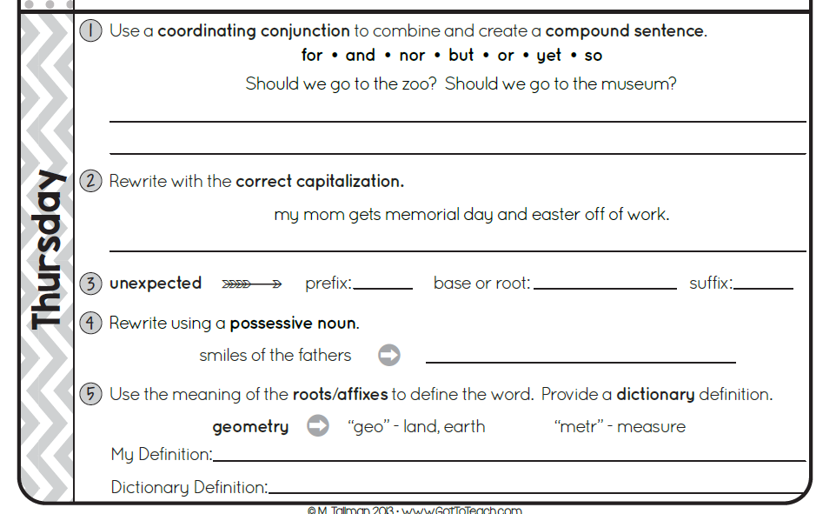

Slide 42
Editing Assessment

