Slide 2
Monday
Day 1

Slide 3
Sonday
Objective: TLW know and apply grade level phonics and word analysis skills when decoding isolated words in text. Use combined knowledge of letters and sound correspondences, syllabications patterns, and morphology (roots & affixes) to accurately read unfamiliar multisyllabic words.

Slide 4
Sonday Lesson 46

Slide 5
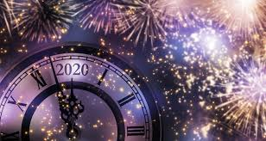
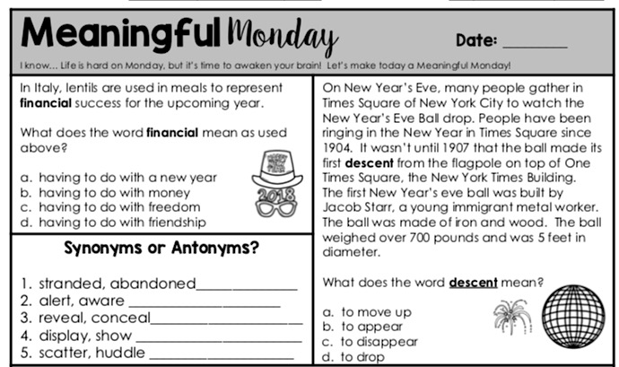
Day 1 Reading Review

Slide 6
READING – DAY 1
CCRA.R.1 Read Closely to determine what the text says explicitly and to make logical inferences from it; cite specific textual evidence when writing or speaking to support conclusions from the text.
ESSENTIAL QUESTION
How have volcanic eruptions shaped our planet?

Slide 7
READING – DAY 1
Reading Day 1:
Storyworks - Mt. Vesuvius
Text Feature Slide Show
Vocabulary Slide Show
Vocabulary Skill Builder
Behind the Scenes
First Read

Slide 8
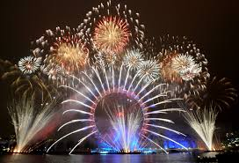
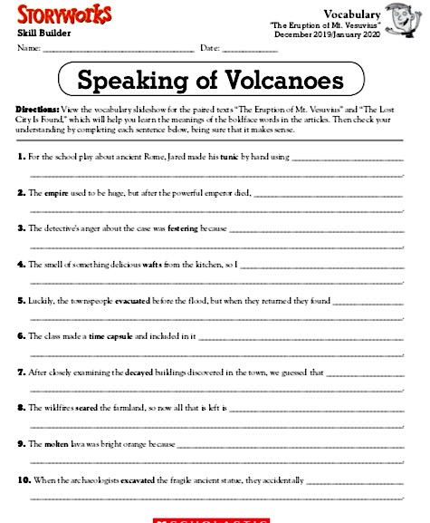
Vocabulary

Slide 9
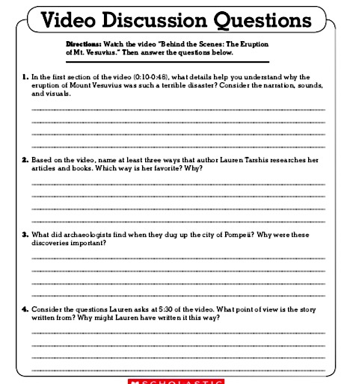
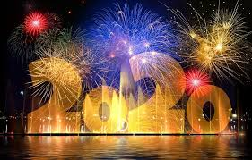

Slide 10
READING – DAY 1
Grammar Day 1:
Objective: Demonstrate command of conventions of standard English grammar and usage when speaking an conventions of standard English grammar and usage, including capitalization and punctuation, when writing.
Relative pronouns and relative adverbs - Progressive verb tenses
Auxiliary verbs - Produce clear sentences
Form and use prepositional phrases - Recognize fragments & run-ons
Use commas & quotations

Slide 11
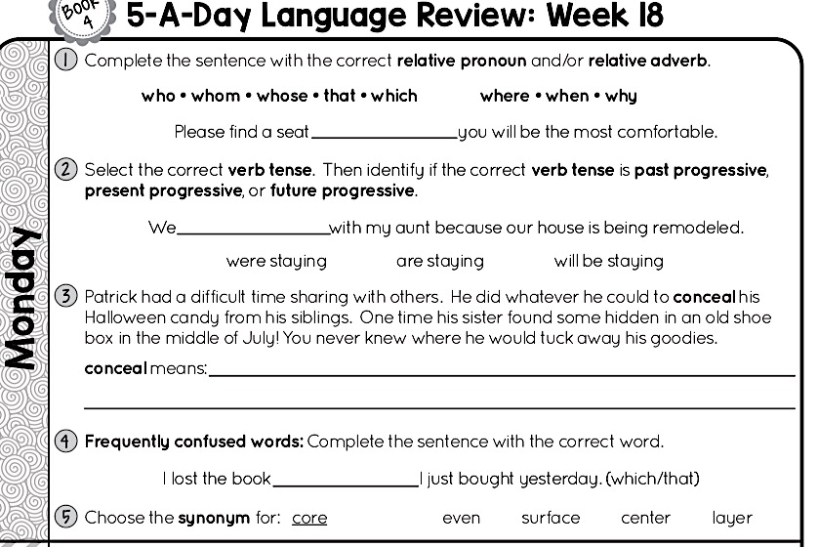

Slide 12
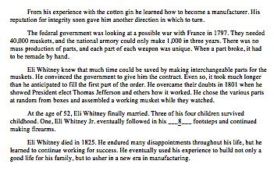
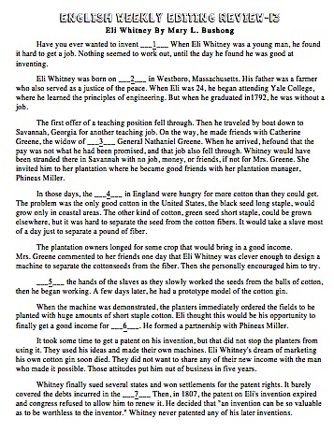
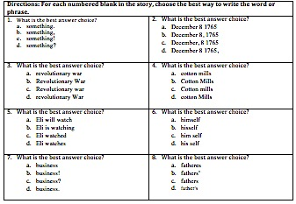

Slide 13
Synonyms & Antonyms ppt.

Slide 14
Day 2
Tuesday

Slide 15
Sonday
Objective: TLW know and apply grade level phonics and word analysis skills when decoding isolated words in text. Use combined knowledge of letters and sound correspondences, syllabications patterns, and morphology (roots & affixes) to accurately read unfamiliar multisyllabic words.

Slide 16
Sonday Lesson 47

Slide 17
Day 2 Reading Review

Slide 18
READING – DAY 1
CCRA.R.1 Read Closely to determine what the text says explicitly and to make logical inferences from it; cite specific textual evidence when writing or speaking to support conclusions from the text.
ESSENTIAL QUESTION
How have volcanic eruptions shaped our planet?

Slide 19
READING – DAY 1
Reading Day 2:
Read/listen to the article again.
Close-reading questions.
Critical-thinking questions

Slide 20
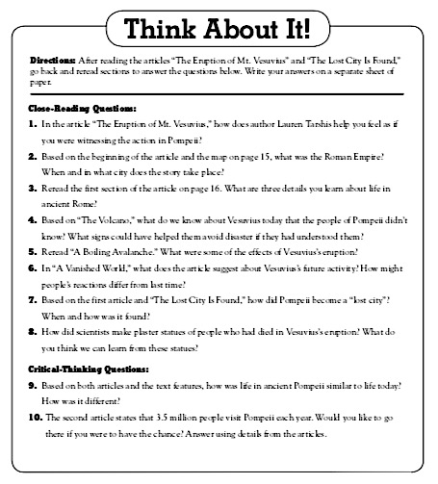

Slide 21
READING – DAY 1
Grammar Day 2:
Objective: Demonstrate command of conventions of standard English grammar and usage when speaking an conventions of standard English grammar and usage, including capitalization and punctuation, when writing.
Relative pronouns and relative adverbs - Progressive verb tenses
Auxiliary verbs - Produce clear sentences
Form and use prepositional phrases - Recognize fragments & run-ons
Use commas & quotations

Slide 23
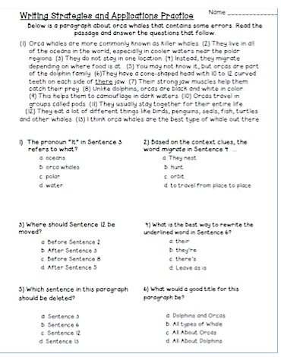
Day 2 - Editing

Slide 24
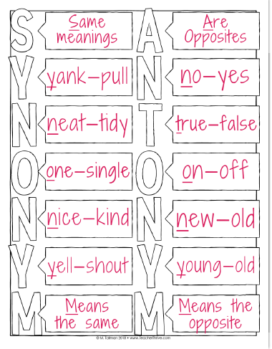
READING – DAY 1
Synonym & Antonym Journal Entry

Slide 25
Day 3
Wednesday

Slide 26
Sonday
Objective: TLW know and apply grade level phonics and word analysis skills when decoding isolated words in text. Use combined knowledge of letters and sound correspondences, syllabications patterns, and morphology (roots & affixes) to accurately read unfamiliar multisyllabic words.

Slide 27
Sonday Lesson 48

Slide 28
Day 3 Reading Review

Slide 29
READING – DAY 1
CCRA.R.1 Read Closely to determine what the text says explicitly and to make logical inferences from it; cite specific textual evidence when writing or speaking to support conclusions from the text.
ESSENTIAL QUESTION
How have volcanic eruptions shaped our planet?

Slide 30
READING – DAY 1
Reading Day 3:
Research project

Slide 31
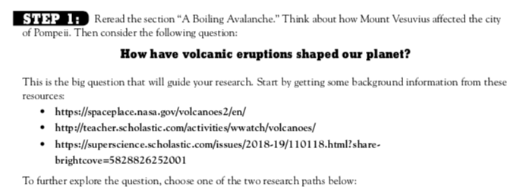
Research Project

Slide 32
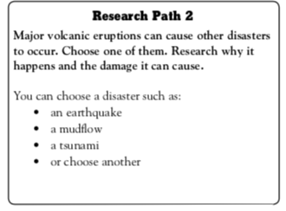
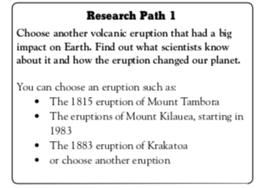
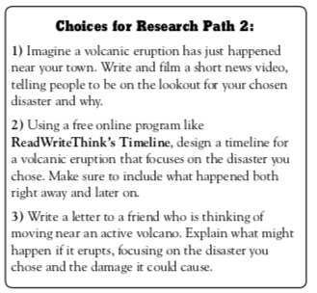
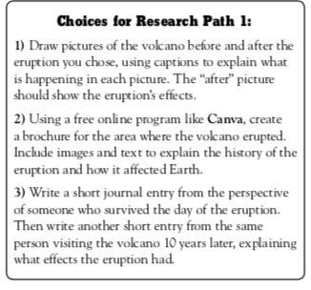
Step 2
Step 2
Step 3 for both paths:
Think about the questions you’ll need to answer to complete your project. Then start to hunt for answers!
**I have books and websites bookmarked for your use.
Step 4
Step 4

Slide 33
READING – DAY 1
Grammar Day 3:
Objective: Demonstrate command of conventions of standard English grammar and usage when speaking an conventions of standard English grammar and usage, including capitalization and punctuation, when writing.
Relative pronouns and relative adverbs - Progressive verb tenses
Auxiliary verbs - Produce clear sentences
Form and use prepositional phrases - Recognize fragments & run-ons
Use commas & quotations

Slide 35
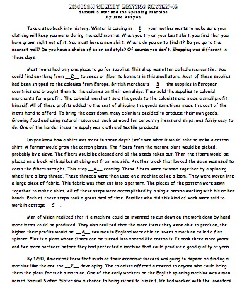
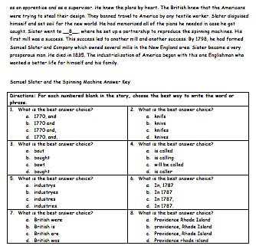
Day 3 - Editing

Slide 36
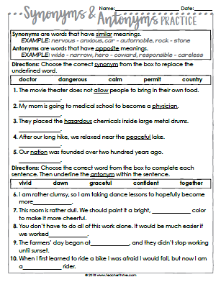

Slide 37
Day 4
Thursday

Slide 38
Sonday
Objective: TLW know and apply grade level phonics and word analysis skills when decoding isolated words in text. Use combined knowledge of letters and sound correspondences, syllabications patterns, and morphology (roots & affixes) to accurately read unfamiliar multisyllabic words.

Slide 39
Sonday Lesson 49

Slide 40
Day 4 Reading Review

Slide 41
READING – DAY 1
CCRA.R.1 Read Closely to determine what the text says explicitly and to make logical inferences from it; cite specific textual evidence when writing or speaking to support conclusions from the text.
ESSENTIAL QUESTION
How have volcanic eruptions shaped our planet?

Slide 42
Writing Prompt
Using your research project, imagine you’ve been invited to work on a dig with archeologists in Pompeii. Write an email to your friends at home to describe what life was like there before 79 A.D. and how scientists figured out that information.

Slide 43
READING – DAY 1
Grammar Day 4:
Objective: Demonstrate command of conventions of standard English grammar and usage when speaking an conventions of standard English grammar and usage, including capitalization and punctuation, when writing.
Relative pronouns and relative adverbs - Progressive verb tenses
Auxiliary verbs - Produce clear sentences
Form and use prepositional phrases - Recognize fragments & run-ons
Use commas & quotations

Slide 44
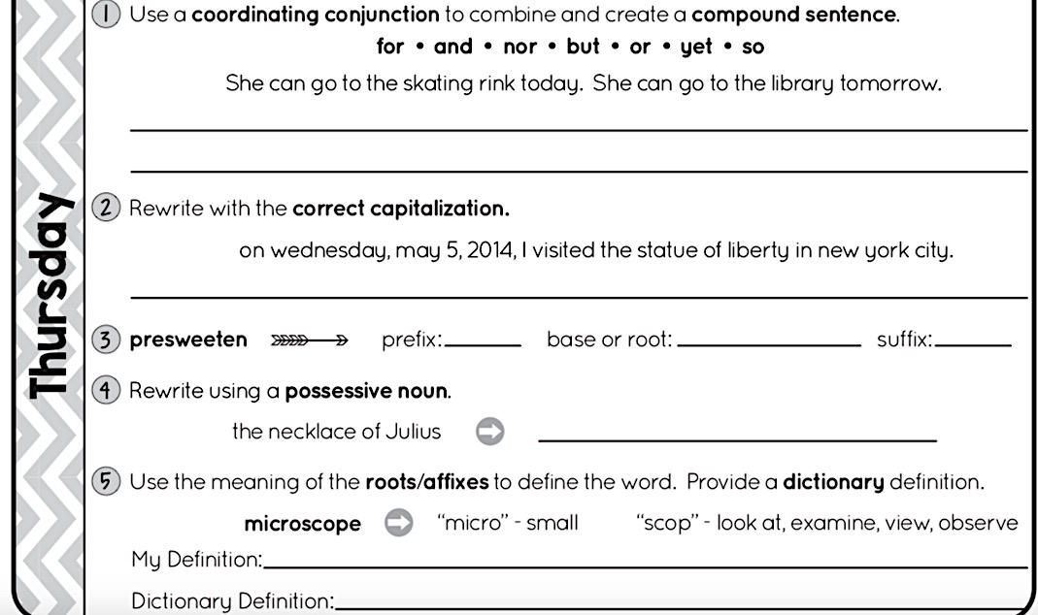

Slide 45
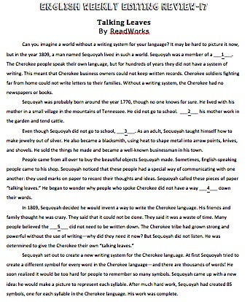
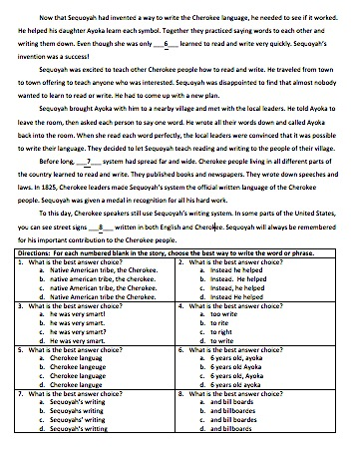

Slide 46
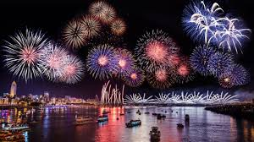
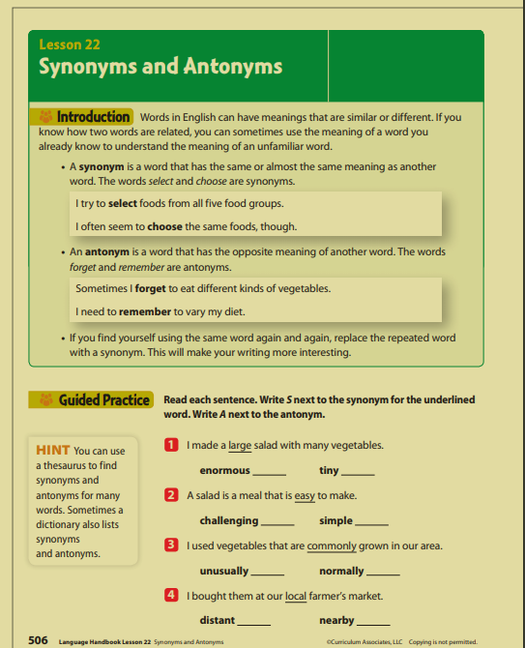
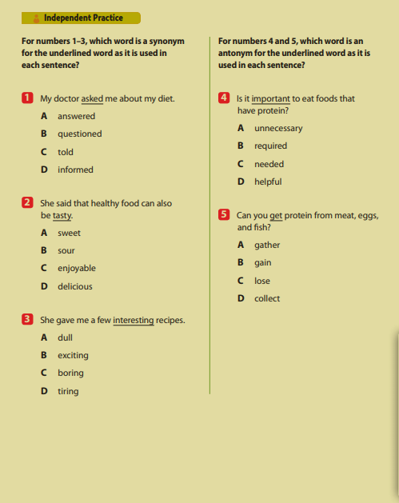

Slide 47
Day 5
Thursday

Slide 48
Day 5 Reading Review

Slide 49
Sonday Lesson 50
Grammar Assessment
Reading Assessment

