Slide 1
ELA March 2-6, 2020

Slide 2
Monday
To Do:
Good Morning Sunshine

Slide 3
Sonday
Objective: TLW know and apply grade level phonics and word analysis skills when decoding isolated words in text. Use combined knowledge of letters and sound correspondences, syllabications patterns, and morphology (roots & affixes) to accurately read unfamiliar multisyllabic words.

Slide 4
Lesson 86
ei (long a) – as in vein
“ei” is not the first choice for long /a/ in the middle

Slide 5
Sonday Practice L86

Slide 6
Standards
Standards Reviewed
R.1, R.2, R.3, R.4, R.7, W.2, SL.1, SL. 2, L.6
Weekly Featured Skill
Main Idea and Details
Essential Question
What was life like for children who worked in coal mines years ago?

Slide 7
Out of the Burning Darkness
Behind the Scenes video & activity page
Vocabulary

Slide 8
Daily Review

Slide 9
Social Studies
Test

Slide 10
Tuesday
To Do:
Good Morning Sunshine

Slide 11
Sonday
Objective: TLW know and apply grade level phonics and word analysis skills when decoding isolated words in text. Use combined knowledge of letters and sound correspondences, syllabications patterns, and morphology (roots & affixes) to accurately read unfamiliar multisyllabic words.

Slide 12
Lesson 87
Sight Words
during
heart

Slide 13
Sonday Practice L87

Slide 14
Standards
Standards Reviewed
R.1, R.2, R.3, R.4, R.7, W.2, SL.1, SL. 2, L.6
Weekly Featured Skill
Main Idea and Details
Essential Question
What was life like for children who worked in coal mines years ago?

Slide 15
Out of the Burning Darkness
Vocabulary video & activity sheet
Discuss illustration pg. 4-5
Up Close Box

Slide 16
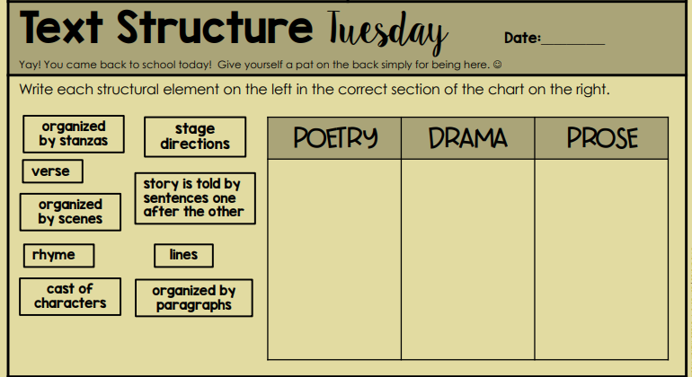
Daily Review

Slide 17
Homework Review

Slide 18
Social Studies
None

Slide 19
Wednesday
To Do:
Good Morning Sunshine

Slide 20
Sonday
Objective: TLW know and apply grade level phonics and word analysis skills when decoding isolated words in text. Use combined knowledge of letters and sound correspondences, syllabications patterns, and morphology (roots & affixes) to accurately read unfamiliar multisyllabic words.

Slide 21
Lesson 88
eigh (long e) – as in eight
Often “eigh” is followed by “t”.

Slide 22
Sonday Practice L88

Slide 23
Standards
Standards Reviewed
R.1, R.2, R.3, R.4, R.7, W.2, SL.1, SL. 2, L.6
Weekly Featured Skill
Main Idea and Details
Essential Question
What was life like for children who worked in coal mines years ago?

Slide 24
Out of the Burning Darkness
First Read

Slide 25
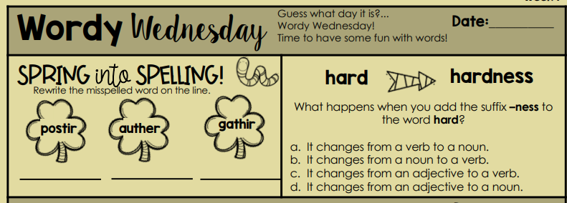
Daily Review

Slide 26
Homework Review

Slide 27
Social Studies
Chapter 11
Powerpoint
Vocabulary
Chapter Opener

Slide 28
Thursday
To Do:
Good Morning Sunshine

Slide 29
Sonday
Objective: TLW know and apply grade level phonics and word analysis skills when decoding isolated words in text. Use combined knowledge of letters and sound correspondences, syllabications patterns, and morphology (roots & affixes) to accurately read unfamiliar multisyllabic words.

Slide 30
Lesson 89 – No new skills
Practice L89

Slide 31
Standards
Standards Reviewed
R.1, R.2, R.3, R.4, R.7, W.2, SL.1, SL. 2, L.6
Weekly Featured Skill
Main Idea and Details
Essential Question
What was life like for children who worked in coal mines years ago?

Slide 32
Out of the Burning Darkness
Close Reading & Critical Thinking

Slide 33
Daily Review

Slide 34
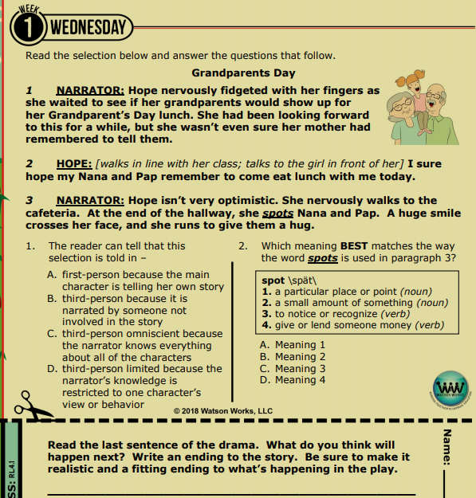
Daily Review

Slide 35
Social Studies
Chapter 11
Review Powerpoint
Text page 85

Slide 36
Friday
To Do:
Good Morning Sunshine

Slide 37
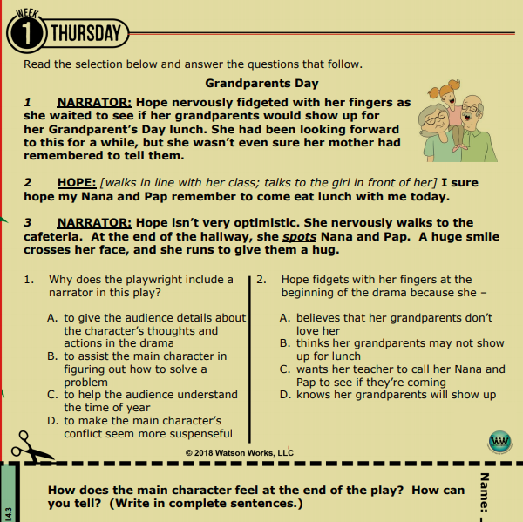
Daily Review

Slide 38
Assessments
Sonday Lesson 90
Literacy Loft (Good Morning Sunshine) March W1
Daily Ready Reading March W1

Slide 39
Standards
Standards Reviewed
R.1, R.2, R.3, R.4, R.7, W.2, SL.1, SL. 2, L.6
Weekly Featured Skill
Main Idea and Details
Essential Question
What was life like for children who worked in coal mines years ago?

Slide 40
Out of the Burning Darkness
Close Reading & Critical Thinking continued

Slide 41
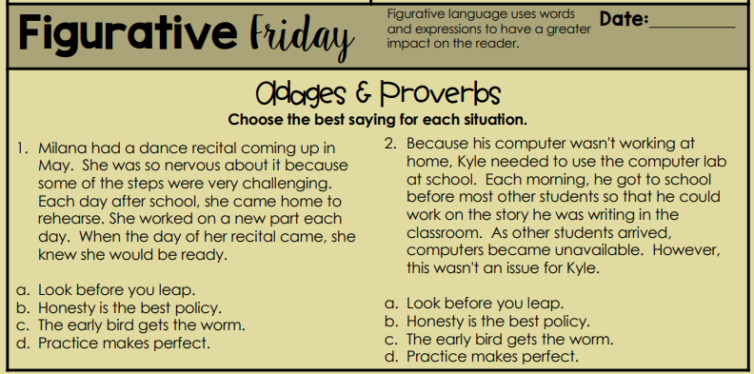
Daily Review

Slide 42
Social Studies
Chapter 10
Review Powerpoint
Text page 86

