Slide 1
ELA December 16th – 20th ^{4th Grade}

Slide 2
Monday Day 1

Slide 3
Day 1 Reading Review

Slide 4
READING – DAY 1
CCRA.R.1 Read Closely to determine what the text says explicitly and to make logical inferences from it; cite specific textual evidence when writing or speaking to support conclusions from the text.
ESSENTIAL QUESTION
How do people become refugees and how do their lives change as a result?

Slide 5
READING – DAY 1
Storyworks:
I Live in a Refugee Camp
Making Inferences

Slide 6
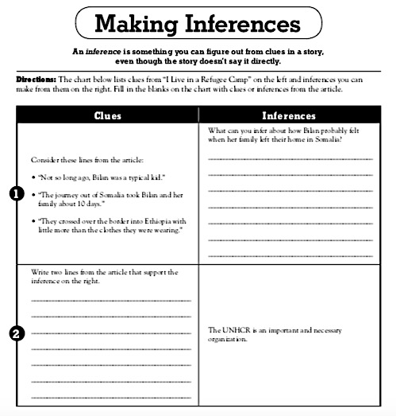
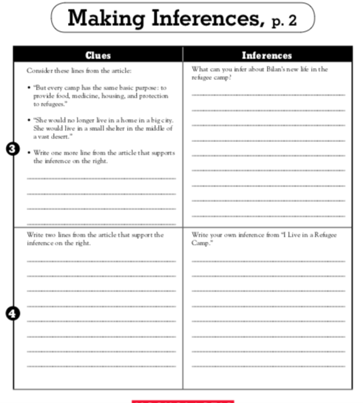

Slide 7
Day 1 Grammar
Objective: Demonstrate command of conventions of standard English grammar and usage when speaking an conventions of standard English grammar and usage, including capitalization and punctuation, when writing.
Relative pronouns and relative adverbs
Progressive verb tenses
Auxiliary verbs
Produce clear sentences
Form and use prepositional phrases
Recognize fragments & run-ons
Use commas & quotations

Slide 8
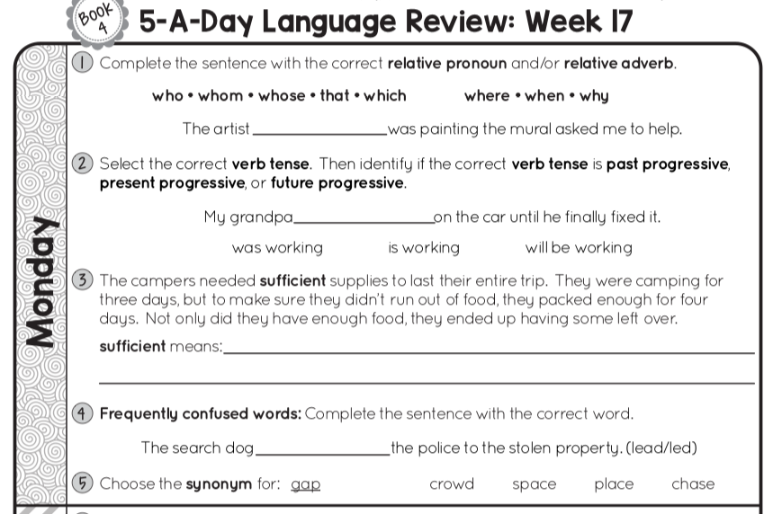

Slide 9
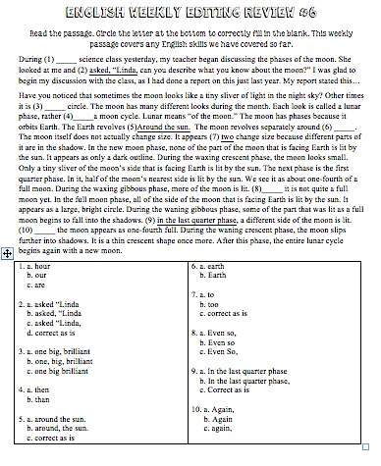
Editing Day 1

Slide 10
Tuesday Day 2

Slide 11
Day 2 Reading Review

Slide 12
Day 2 Reading Day 2
CCRA.R.1 Read Closely to determine what the text says explicitly and to make logical inferences from it; cite specific textual evidence when writing or speaking to support conclusions from the text.
ESSENTIAL QUESTION
Whow do people become refugees and how do their lives change as a result?

Slide 13
READING – DAY 2
Storyworks:
Review for test

Slide 14
Day 2 Grammar
Objective: Demonstrate command of conventions of standard English grammar and usage when speaking an conventions of standard English grammar and usage, including capitalization and punctuation, when writing.
Relative pronouns and relative adverbs
Progressive verb tenses
Auxiliary verbs
Produce clear sentences
Form and use prepositional phrases
Recognize fragments & run-ons
Use commas & quotations

Slide 15
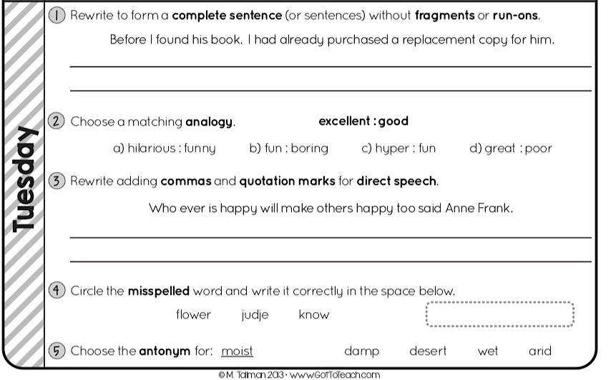

Slide 16
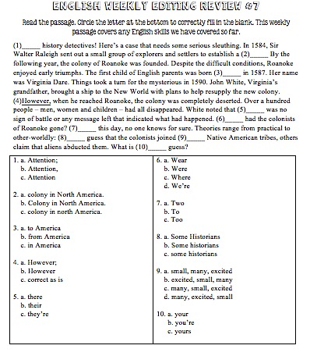
Editing Day 2

Slide 17
Idioms ppt ((link on planbook)

Slide 18
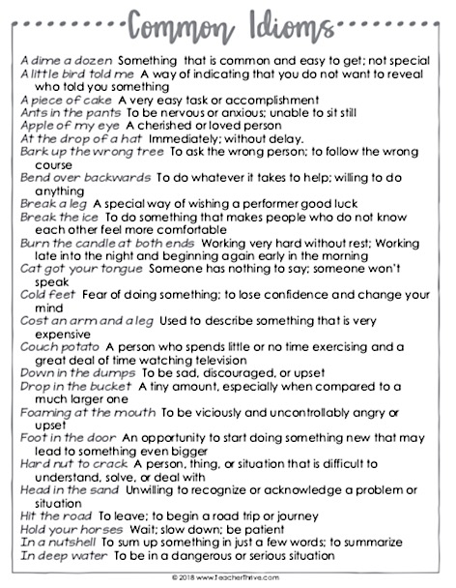
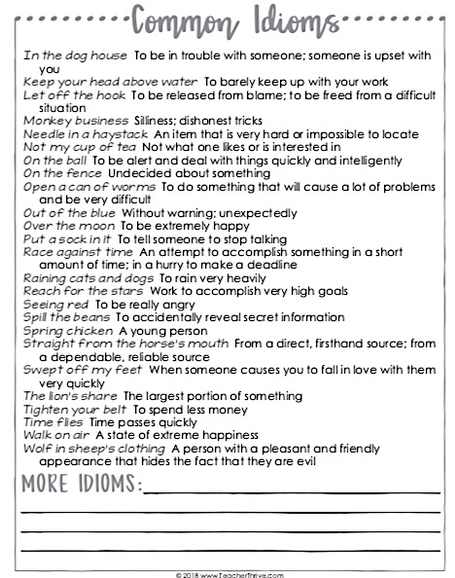

Slide 19
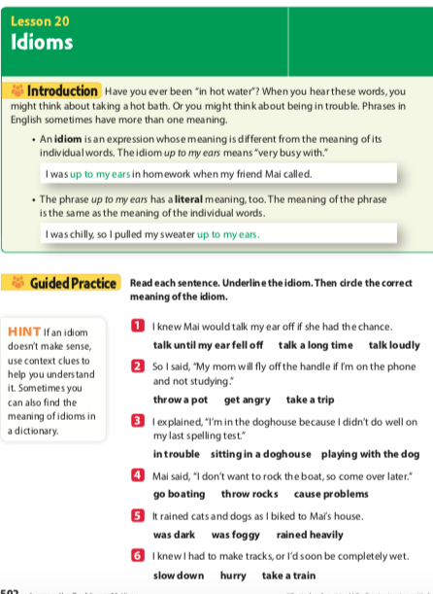
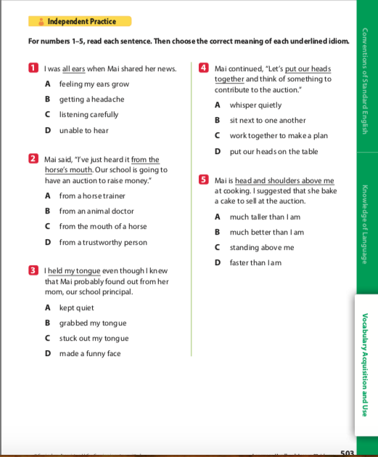

Slide 20
Wednesday Day 3

Slide 21
Day 3 Reading Review

Slide 22
Day 3 Reading
I Live in a Refugee Camp test

Slide 23
Day 3 Grammar
Objective: Demonstrate command of conventions of standard English grammar and usage when speaking an conventions of standard English grammar and usage, including capitalization and punctuation, when writing.
Relative pronouns and relative adverbs
Progressive verb tenses
Auxiliary verbs
Produce clear sentences
Form and use prepositional phrases
Recognize fragments & run-ons
Use commas & quotations

Slide 25
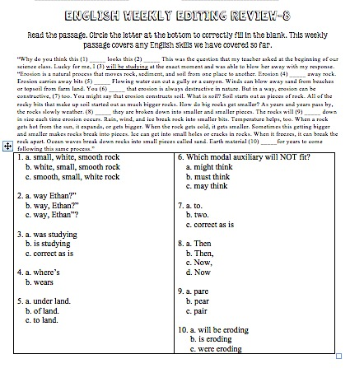
Editing Day 3

Slide 26
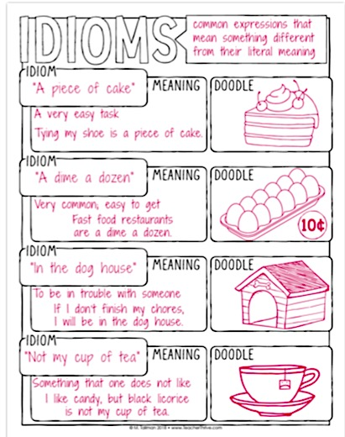
Idioms

Slide 27
Thursday Day 4

Slide 28
Day 4 Reading Review

Slide 29
Day 4 Grammar
Objective: Demonstrate command of conventions of standard English grammar and usage when speaking an conventions of standard English grammar and usage, including capitalization and punctuation, when writing.
Relative pronouns and relative adverbs
Progressive verb tenses
Auxiliary verbs
Produce clear sentences
Form and use prepositional phrases
Recognize fragments & run-ons
Use commas & quotations

Slide 30
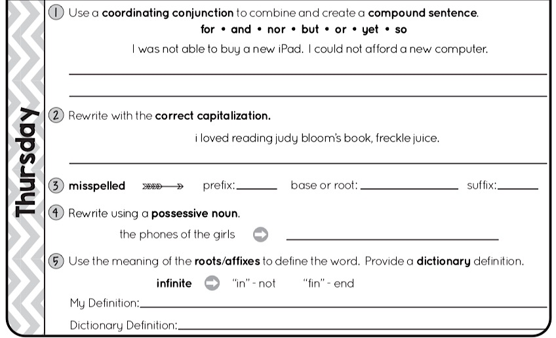

Slide 31
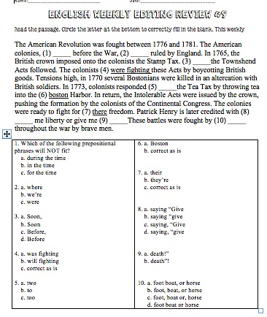
Editing Day 4

Slide 32
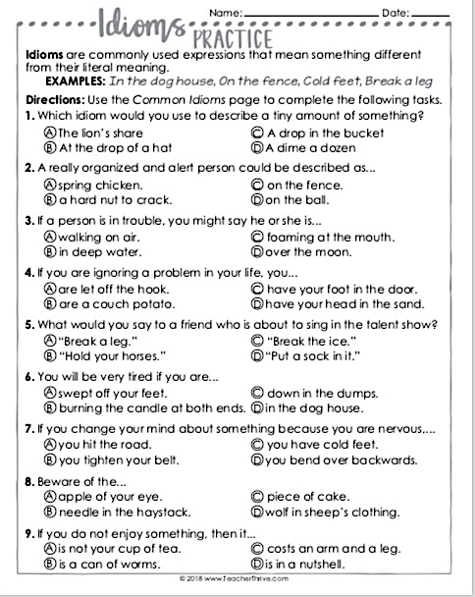

Slide 33
Friday Day 5

